Slide 1
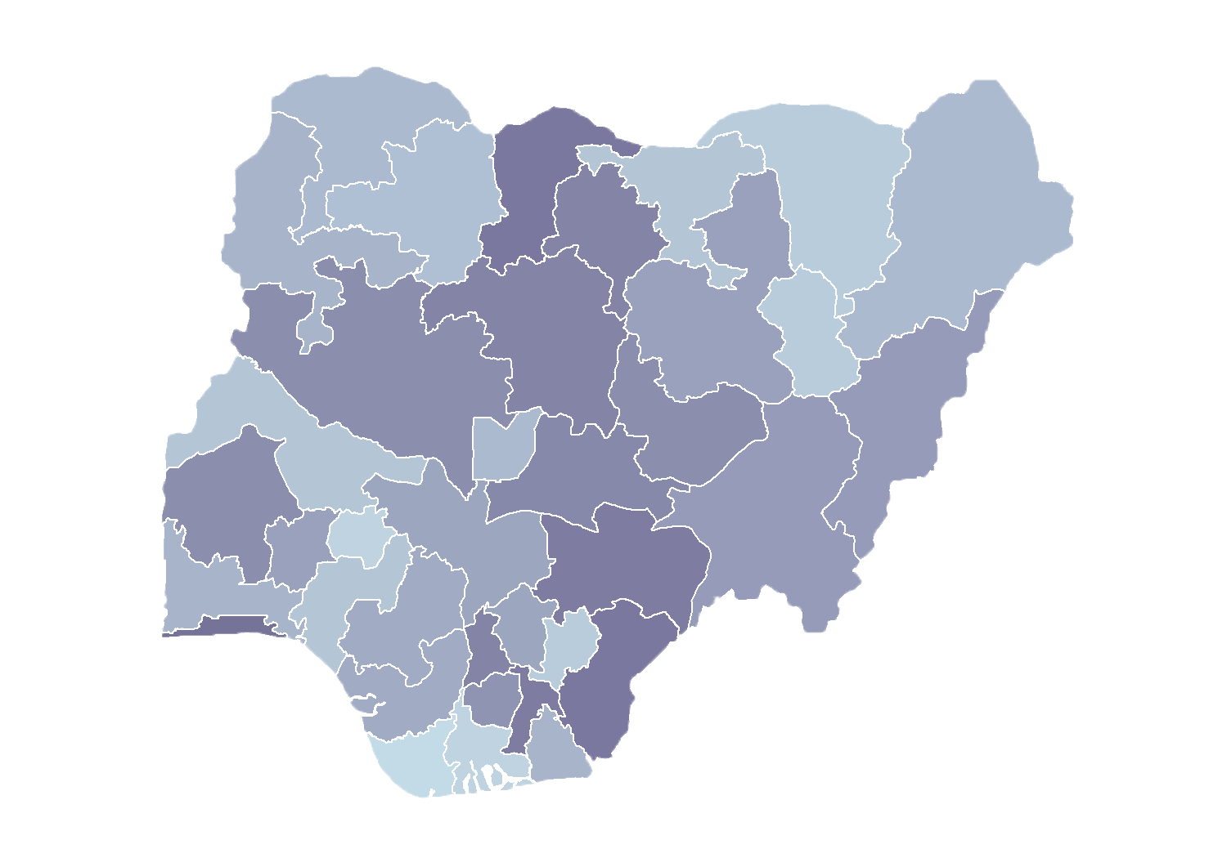
Module 1.4
Vision for the
Master Facility List
Rollout of Health Facility Registry/Master Facility List for States and Local Government Areas in Nigeria
March 2019

Slide 2
Outline
Health facility registry (HFR) rollout
District health information software (DHIS 2) and HFR integration
Sustained governance
Perspectives on sustainability
Discussion

Slide 3
HFR
rollout

Slide 4
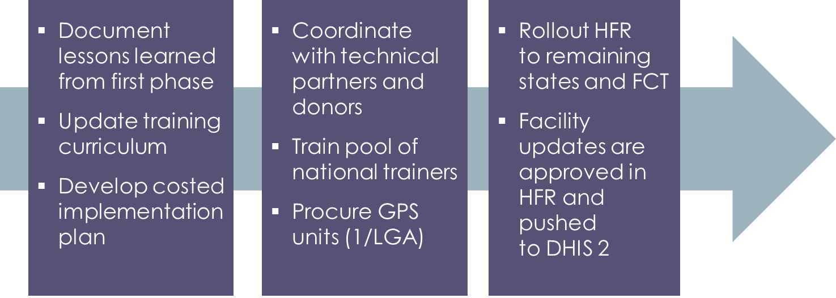
National timeline
May/June
2019
July/Aug.
2019
To be determined
Master facility list (MFL) fully implemented in Nigeria

Slide 5
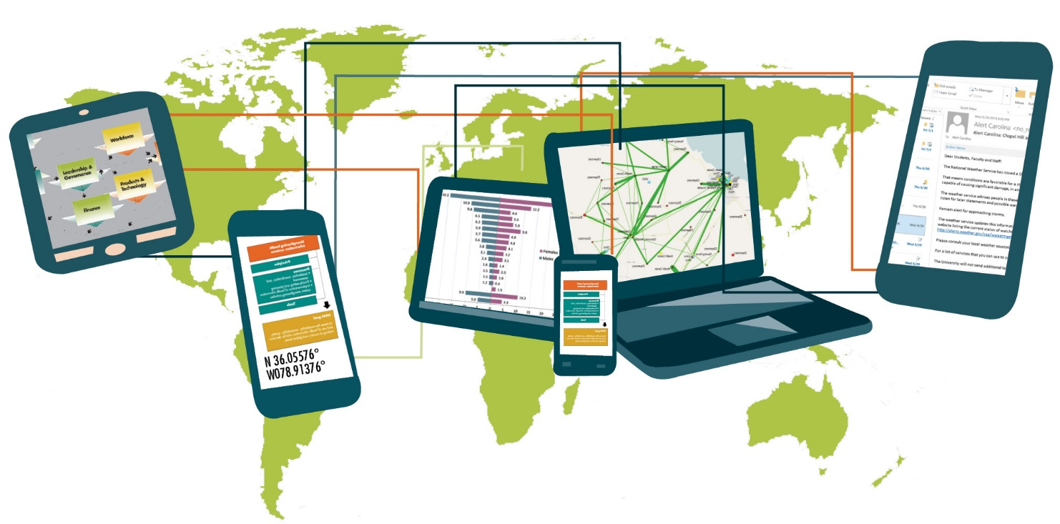
DHIS 2 and HFR
integration

Slide 6
Integration
What is it?
Process of linking multiple information systems to create a unified solution
Integration with the MFL will enable DHIS 2 to access the most recent (updated) information
This ensures that the HFR is the single source of facility information in the country
Notes:
Integration is the process of physically or functionally linking multiple information systems to create a combined system or unified solution.

Slide 7
Integration
Progress
Collaboration with the Health Information System Program (HISP), Nigeria, and the National Health Management Information System (NHMIS) team to facilitate the following:
Attribute mapping
Agree on minimum data elements required by DHIS 2
Data mapping and cleaning between HFR and DHIS 2

Slide 8
Data mapping
HFR
39,550
DHIS 2
39,060
7,958 facilities in DHIS 2, but not in HFR
7,567 facilities in HFR, but not in DHIS 2
31,460
17,384 facilities exactly matched
123 duplicates identified
One consolidated list identical in DHIS 2 and HFR
14,076 facilities matched with similarity

Slide 9
Key deliverables
What next?
Update HFR and DHIS 2 with updated information from mapping exercise
Develop data exchange mechanism in both systems (application programming interfaces)
Test data exchange in staging servers
Implement data exchange in production server (go live)

Slide 10
Integrated systems
Future process
New facilities or facility updates will be done in the HFR
DHIS 2 will henceforth rely on HFR for facility list updates
Facility information will be reviewed and approved in the HFR
Once approved, the HFR will send the updates to the DHIS 2

Slide 11
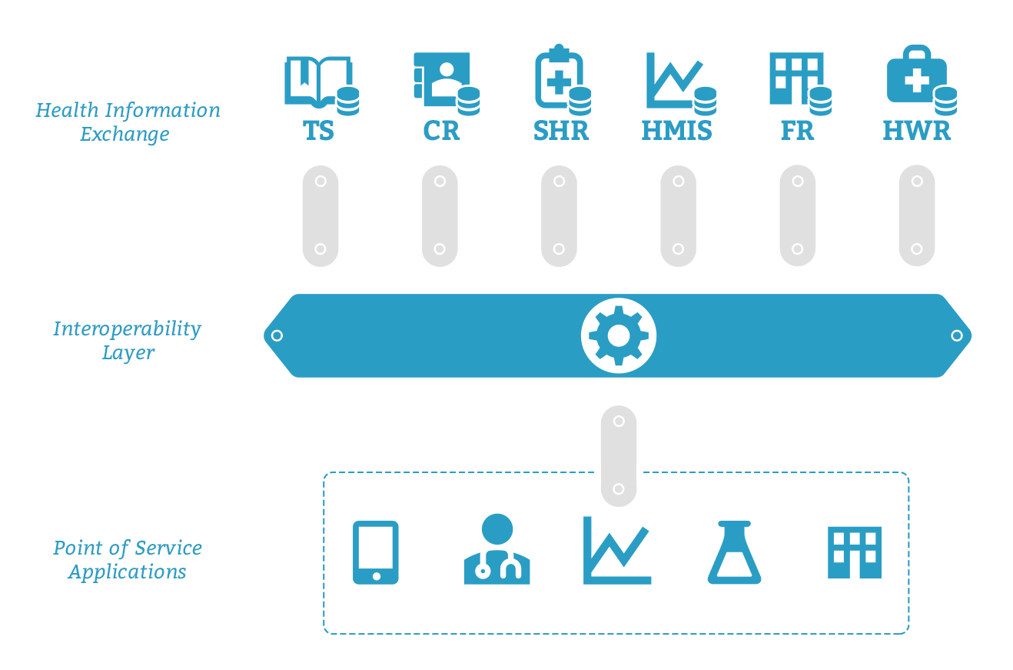
Future perspectives
Interoperability layer (IL)
OpenHIE architecture
Source: https://ohie.org
Notes:
The interoperability layer is the component that enables easier interoperability between disparate information systems by connecting the infrastructure services and client applications together. An interoperability layer receives transactions from external systems and coordinates interaction between components of the HIE and provides common core functions to simplify the interoperability between systems.

Slide 12
Sustained
governance

Slide 13
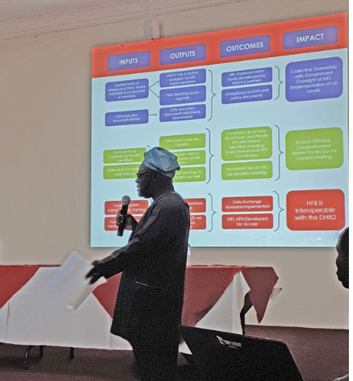
Monitoring and evaluation framework
The MFL Technical Working Group (TWG) developed the national MFL/HFR monitoring and evaluation (M&E) framework to track and assess nationwide rollout and implementation.
The acting head of M&E (Department of Health Planning and Statistics), Federal Ministry of Health presenting the M&E framework.

Slide 14
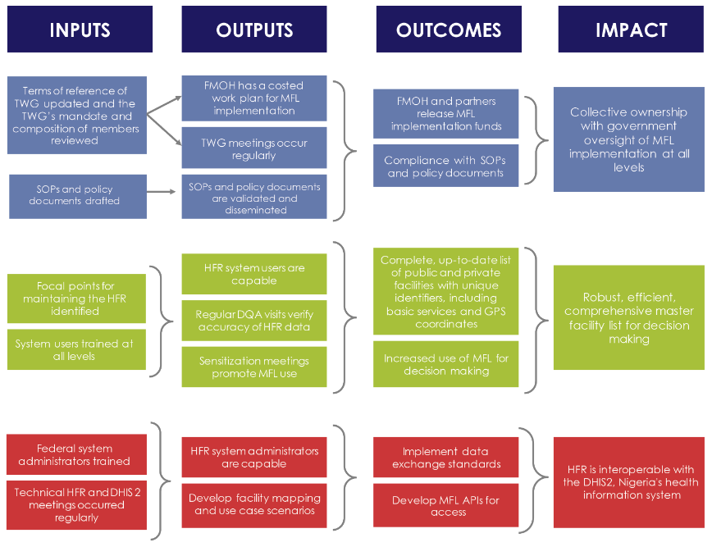
M&E framework
Notes:
The overall long-term goals for the MFL include:
Collective ownership with government oversight of MFL implementation at all levels
Robust, efficient, comprehensive master facility list for decision making
HFR is interoperable with the DHIS 2, Nigeria’s health information system

Slide 15
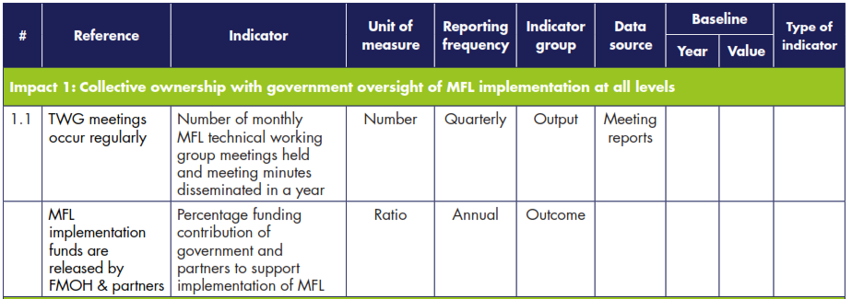
MFL TWG to report on
engagement of partners. . .
. . .in national rollout and maintenance of the HFR/MFL
Notes:
The MFL TWG provides a forum for reporting to technical and financial partners.
Therefore, holding regular meetings of the MFL TWG during the year is an important process indicator.

Slide 16
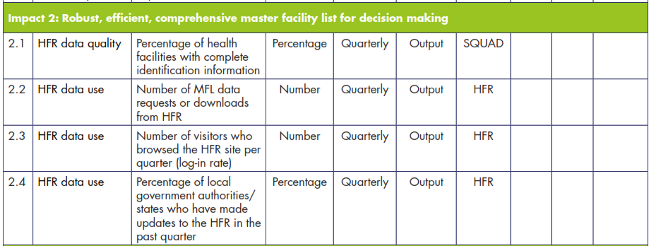
TWG to report on
HFR data quality and data use. . .
. . .using the Spatial Quality and Anomalies Diagnosis (SQUAD) tool and internal tracking

Slide 17
TWG to report on
capacity to maintain the HFR. . .
. . .ensuring the maintenance of the HFR and integration with the DHIS 2

Slide 18
Perspectives on sustainability

Slide 19
Sustainability of HFR
The Tanzania experience
The Government of Tanzania (GOT) saw the value of the HFR in the following areas:
Allocation of resources to health sector
Ability of the HFR to track facilities’ license status in real time
Visibility of all health facilities providing services
Ability to use the geocoordinates to visit all facilities

Slide 20
Sustainability of HFR
GOT
The GOT developed a facility registration module to manage business processes online for both public and private facilities which:
Includes registration of owners of facilities
Integrates with government electronic payment
Generates alerts and reports to identify facilities which have expired licenses
Sends automatic status reports to all government leaders responsible for health services!

Slide 21
Sustainability of HFR
Benefits of registration module
Time was reduced for the registration of new facilities.
It reduced the cost to the owners of facilities, because they no longer need to travel long distances for registration purposes.
Compliance to pay annual fees has gone up because all processes are now online.
Government is able to query active status of all facilities easily.
Collection of annual fees has increased.

Slide 22
Sustainability of HFR
GOT financed the development of this module without donor support.
GOT has increased resources to monitor the quality of services provided by health facilities.
The GOT is able to support maintenance of the system by using its own funds.
GOT is now using HFR data for all budgeting purposes.

Slide 23
Discussion

Slide 24
Discussion
Given the Tanzania experience. . .
What did you learn?
How can you use the HFR to improve facility management in your state/local government area?
What opportunities are open that should be taken advantage of?

